Slide 1
Why Hashing ?
For a huge database structure,
-- it is impossible to search all the index values through all its level and then reach the destination data block to retrieve the desired data

Slide 2








What is Hashing?
Hashing is an effective technique to calculate the direct location of a data record on the disk without using index structure.
Hashing uses hash functions on search keys to generate the address of a data record.

Slide 3



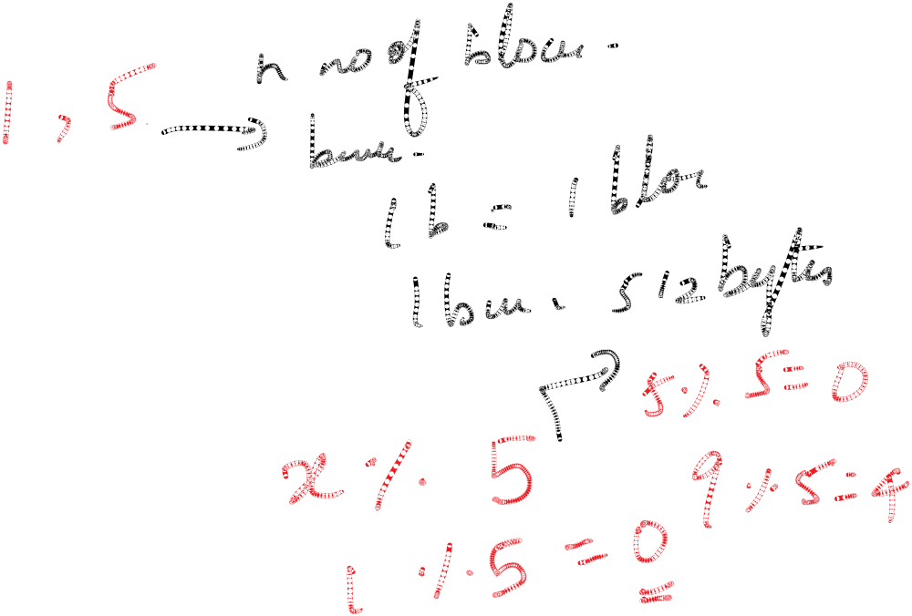
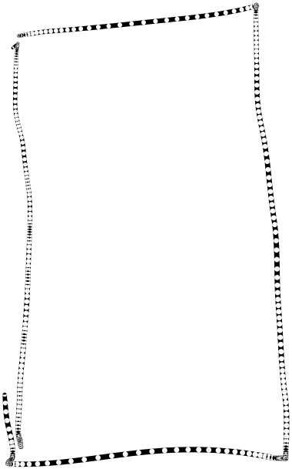




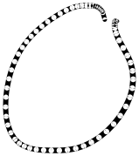
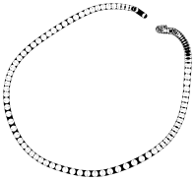


Slide 4
Terminologies
Bucket − A hash file stores data in bucket format. Bucket is considered a unit of storage.
A bucket typically stores one complete disk block, which in turn can store one or more records.
Hash Function − A hash function, h, is a mapping function that maps all the set of search-keys K to the bucket addresses B, where actual records are placed.
hash(K)= K mod n, n is a fixed value for all search keys.
= B

Slide 5
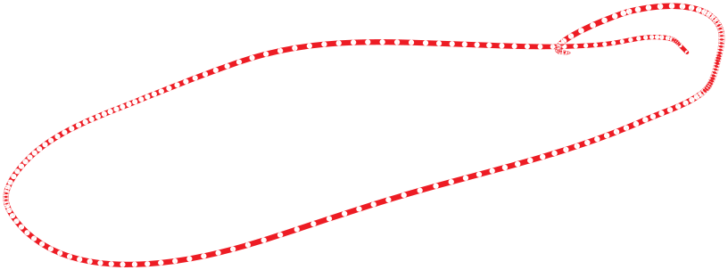
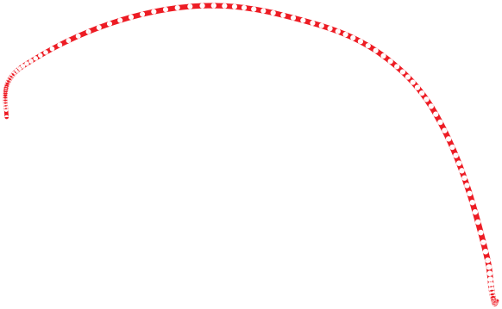
















Slide 6
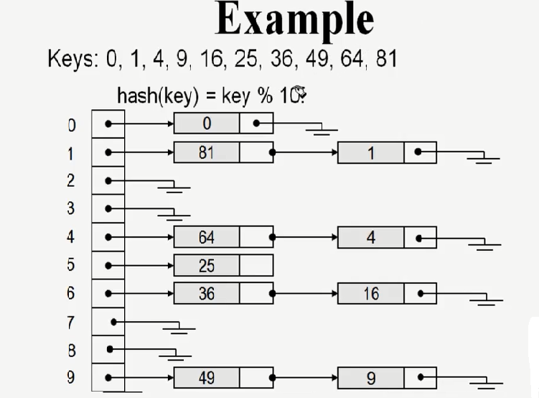
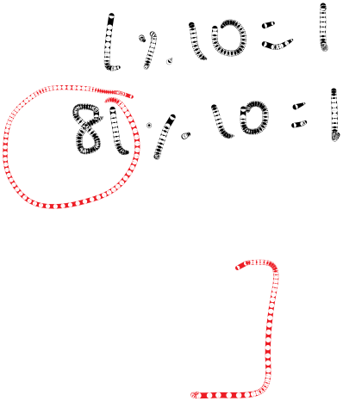
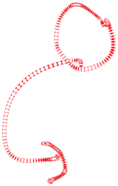

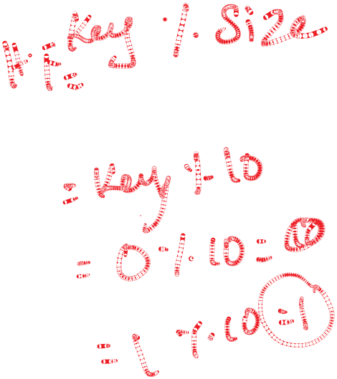

Slide 7
Properties of hash function
A good hash function should be:
Uniform and random distribution
Easy to compute
Less Collision

Slide 8


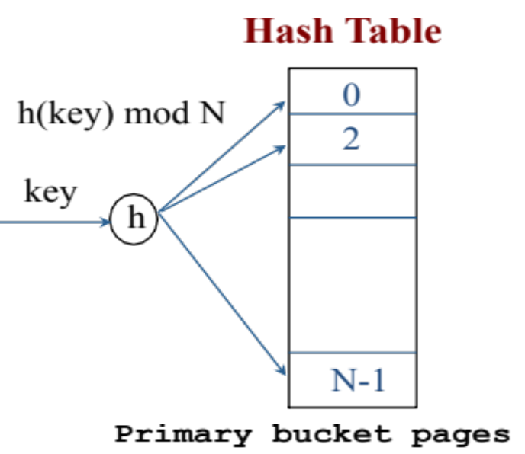



Static Hashing
Hash Table/File consists of primary N buckets.
Each bucket is capable of holding exactly one disk block and the disk block in turn consists of one or more records.
Hashing function h(k) maps key k to bucket addresses b.
Each bucket is one disk block
Notes:
3

Slide 9
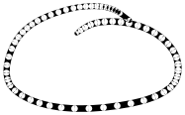

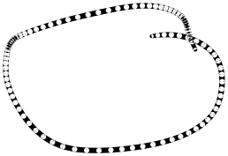


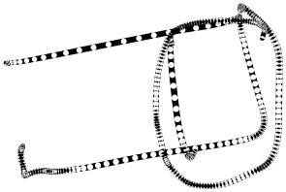




Slide 10

Example Hash Functions
Each bucket is one disk block
Good Hash Function
Uniform and random distribution of keys
Less collision
Easy to compute
If the key k is integer, e.g., 100
  Hash function: k mod N
If the key k is n-byte character string, e.g., “abcd”
  Hash function: add (x1 + x2 + ….. Xn) mod N
Notes:
3

Slide 11





Slide 12
Open Hashing
When a hash function generates an address at which data is already stored, then the next bucket will be allocated to it. This mechanism is called as Linear Probing.

Slide 13

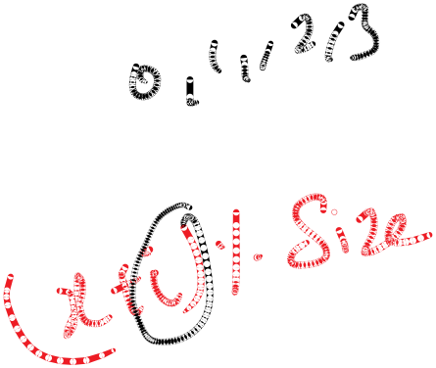







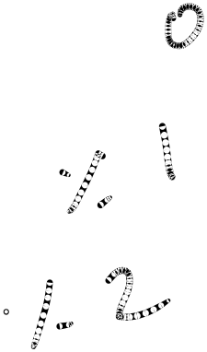

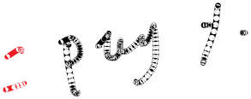



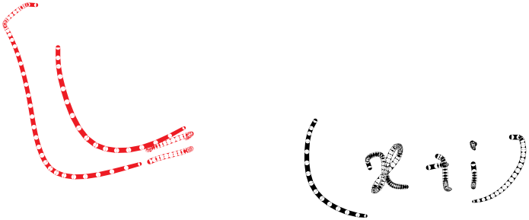






Hash Table(Linear probing)
We have 4 buckets (N=4)
Each bucket holds 2 keys (Size of each bucket=2)
Insert keys a, b, c, and d
INSERT:
h(a) = 1
h(b) = 2
h(c) = 1
h(d) = 0
0
1
2
3
d
a
c
b

Slide 14
2. Close Hashing
When buckets are full, then a new data bucket is allocated for the same hash result and is linked after the previous one. This mechanism is known as Overflow chaining.

Slide 15


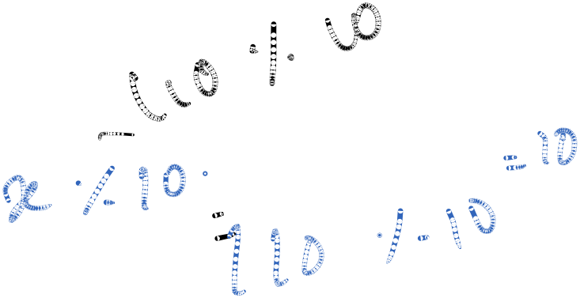

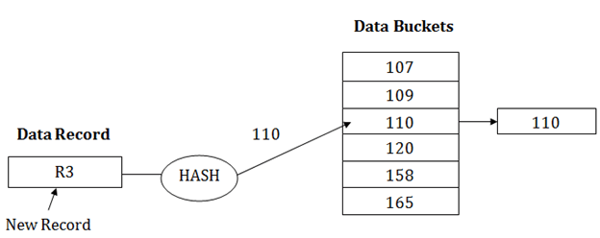

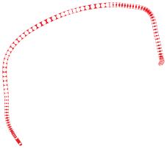


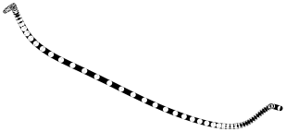



Suppose R3 is a new address which needs to be inserted into the table, the hash function generates address as 110 for it. But this bucket is full to store the new data. In this case, a new bucket is inserted at the end of 110 buckets and is linked to it

Slide 16
Operations on Hash Table
Look-up (Search)
Insertion
Deletion

Slide 17
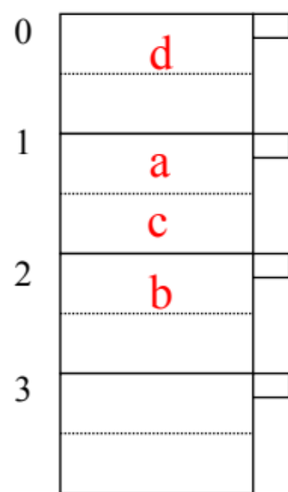
Hash Table: Lookup (Search)
Search for key = d
Remember: Only equality search
1- Apply the hash function over d ➔ h(d) = 0
2- Read the disk block of bucket 0
3- Search for key d
- If keys are sorted, then search using Binary search

Slide 18
Hash Table: Insertion with Overflow
Insert key e ➔ h(e) = 1
Create an overflow bucket and insert e
Overflow bucket is another disk block
0
1
2
3
d
a
e
c
b
When Searching
Remember to check the overflow buckets (if exist)

Slide 19




Hash Table: Deletion
Search for the key to be deleted
In case of overflow buckets
  The overflow bucket may no longer be needed
0
1
2
3
d
a
e
c
b

Slide 20
EXAMPLE: Deletion
Assume the following Hash Table
0
1
2
3
a
Delete:
e
f
b
d
c
d
c
e
f
maybe move
“g” up
g

Slide 21



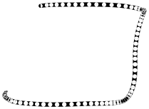

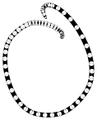

Deficiencies of Static Hashing
Bucket size is fixed
If initial number of buckets is too small, and file grows, performance will degrade due to too much overflows.
If space is allocated for anticipated growth, a significant amount of space will be wasted initially (and buckets will be under full).
If database shrinks, again space will be wasted.
Solution ➔ Dynamic Hashing

Slide 22
Dynamic Hashing
The number of primary buckets is not fixed and it can grow
Our focus
Extensible Hashing
Others …

Slide 23
This hashing method is used to overcome the problems of static hashing – bucket overflow. In this method of hashing, data buckets grows or shrinks as the records increases or decreases.
This method of hashing is also known as extendable hashing method. Let us see an example to understand this method.
Consider there are three records R1, R2 and R4 are in the table. These records generate addresses 100100, 010110 and 110110 respectively.
This method of storing considers only part of this address – especially only first one bit to store the data. So it tries to load three of them at address 0 and 1.

Slide 24





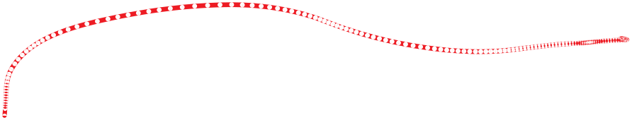



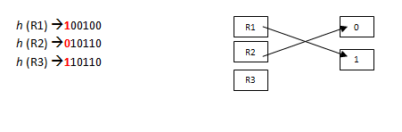





What will happen to R3 here? There is no bucket space for R3. The bucket has to grow dynamically to accommodate R3. So it changes the address have 2 bits rather than 1 bit, and then it updates the existing data to have 2 bit address. Then it tries to accommodate R3.

Slide 25
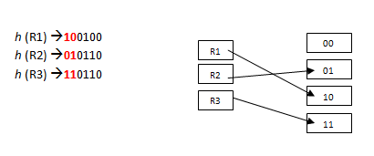







Slide 26
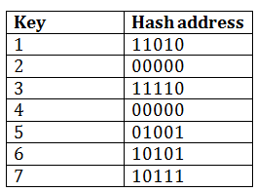
For example:
Consider the following grouping of keys into buckets, depending on the prefix of their hash address:
DBMS Dynamic Hashing

Slide 27
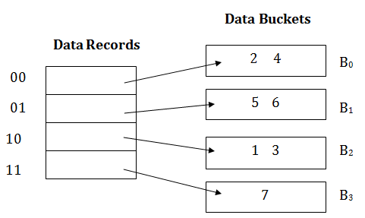
The last two bits of 2 and 4 are 00. So it will go into bucket B0. The last two bits of 5 and 6 are 01, so it will go into bucket B1.
The last two bits of 1 and 3 are 10, so it will go into bucket B2. The last two bits of 7 are 11, so it will go into B3.

Slide 28
Insert key 9 with hash address 10001 into the above structure:
Since key 9 has hash address 10001, it must go into the first bucket. But bucket B1 is full, so it will get split.
The splitting will separate 5, 9 from 6 since last three bits of 5, 9 are 001, so it will go into bucket B1, and the last three bits of 6 are 101, so it will go into bucket B5.
Keys 2 and 4 are still in B0. The record in B0 pointed by the 000 and 100 entry because last two bits of both the entry are 00.
Keys 1 and 3 are still in B2. The record in B2 pointed by the 010 and 110 entry because last two bits of both the entry are 10.
Key 7 are still in B3. The record in B3 pointed by the 111 and 011 entry because last two bits of both the entry are 11.

Slide 29
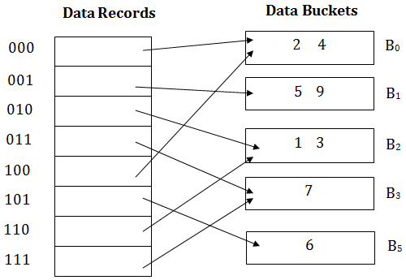



Slide 30
Static Hashing Vs Dynamic Hashing
Static Hashing
Dynamic Hashing
Numbers of buckets and size are fixed
As the file grows, performance decreases.
Space overhead is more
Various forms of static hashing: Open hashing and Closed hashing.
Here we do not use Bucket Address table.
Here system directly accesses the Bucket.
Numbers of Buckets and size are not fixed.
Performance do not degrade as the file grows.
Minimum space overhead.
Various forms of dynamic hashing: Extendable hashing and Linear hashing.
Bucket address table is used.
Here the Bucket address table is accessed before accessing the Bucket.

Slide 31
EXAMPLE PROBLEM
Suppose that extendable hashing is being used on a database file that contains records with the following search key values: 2, 3, 5, 7, 11, 17, 19, 23, 29, 31 a) Construct the extendable hash structure for this file if the hash function is h(x) = x mod 7 and each bucket can hold three records.

